Slide 1
Cyclistic: Maximizing the Number of Annual Memberships
Case Study for Google Data Analytics Certification by Michael Kinison

Slide 2
Scenario
The director of marketing concludes the company’s future success depends on maximizing the number of annual memberships as annual members are much more profitable than casual riders.
Therefore, I want to understand how casual riders and annual members use Cyclistic bikes differently.
From these insights, I will design a new digital marketing strategy to convert casual riders into annual members.

Slide 3
Data Collection
Trip data was provided by Cyclistic for the past year as monthly reports(September 2020 - September 2021).
Data was combined into 1 dataset to make analyzing easier
~ 9.5% of data was missing for the “Starting Station” of the bicycle (543,198 missing of 5,669,219 total records)

Slide 4
Casual vs Members
Rider Type | Total Trip Time (HH:MM:SS) | Mean Trip Time (HH:MM:SS) | Total Trips Taken
Casual | 1399254:32:28 | 00:32:26 | 2,588,979
Membership | 590643:49:28 | 00:11:30 | 3,080,240
Although riders who had a Membership took about 19% more total trips, Casual riders rode bikes about 3X longer.

Slide 5
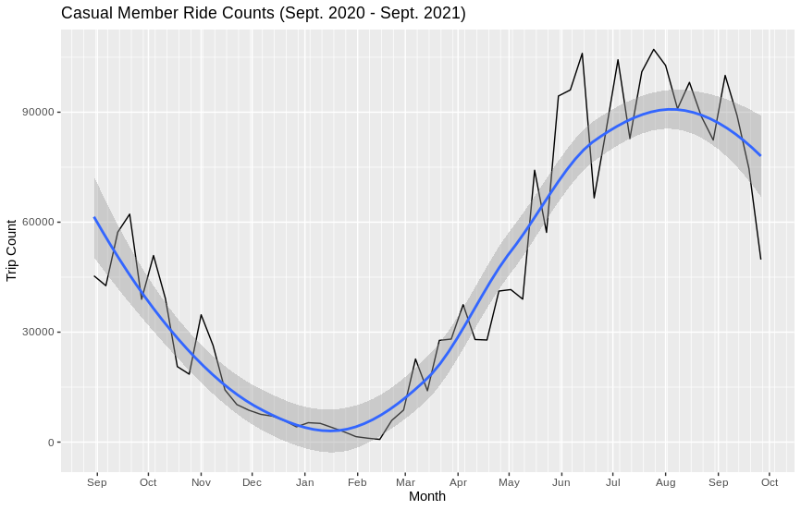
Marketing to Casuals - When?
No Surprise! People ride bikes more in the warmer months.

Slide 6
Marketing to Casuals - When Exactly?
Sunday | 489,251
Monday | 294,012
Tuesday | 274,189
Wednesday | 287,049
Thursday | 298,605
Friday | 372,386
Saturday | 573,487
Again, not many surprises here. Casual riders have more trip counts on the weekend (Fri, Sat, and Sun)

Slide 7
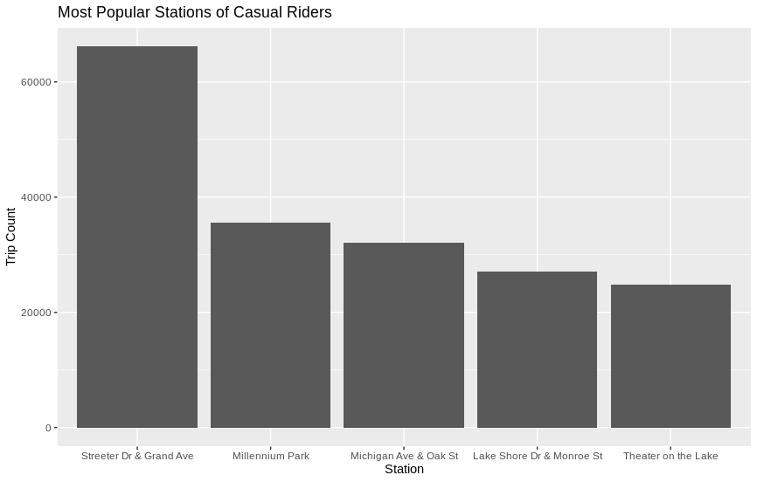
Marketing to Casuals - Ok, Where?
Top 5 Stations for Casual riders.

Slide 8
Insights and Recommendations
Since the average ride length for Casual riders is almost 3X longer than a Membership rider, they could potentially save money by converting to a Membership.
More Casual riders can be reached if marketing is targeted toward them during the summer months, and especially on the weekends.
Geofencing can be used in digital marketing efforts to target Casual riders at specific stations.

Slide 9
Suggestions
If I had access to customer data, then I could tie personal information to trip data. This would allow for an email marketing campaign for conversion of users from Casual to a Membership. Would also allow me to find the users that it really would be beneficial to convert to a Membership.

Slide 10
Questions and Comments
Thank You!
Data source: https://divvy-tripdata.s3.amazonaws.com/index.html

